Slide 1
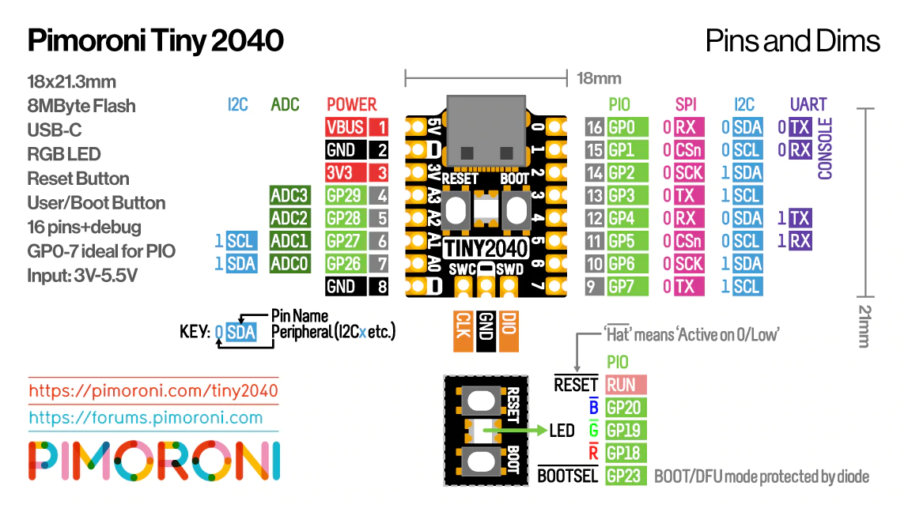

Slide 2
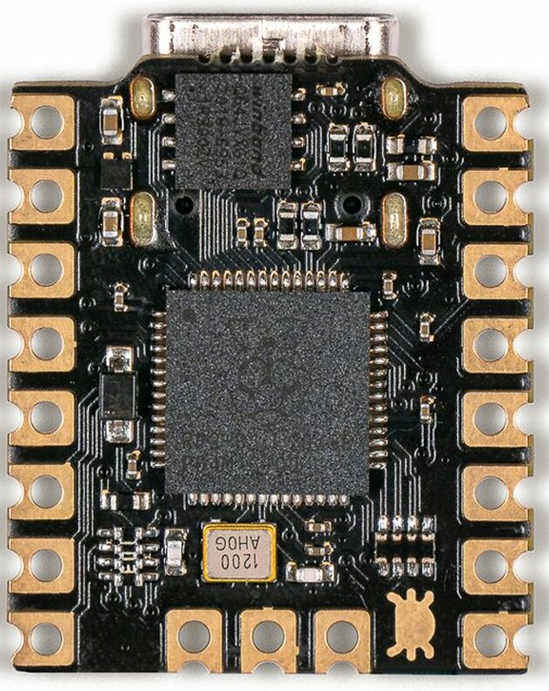
FOR USE WITH INVERTED ORIENTATION!!!

